Slide 1


Introduction to Linear Regression
Notes:
Linear regression analysis is a method of analyzing data that has two or more variables. By creating the "best fit" line for all the data points in a two-variable system, values from one variable can be predicted from another variable. This module starts by presenting simple linear regression models. The implementation of the model in R is then illustrated. Important concepts such as residual analysis of the models as well as the coefficient of determination are subsequently covered. Finally, multiple regression models including categorical variables are discussed.

Slide 2
Predictive Models: Simple Linear Regression
Prediction: If you know something about X, this knowledge helps you predict something about Y.
When considering correlation, both X and Y are treated equally. In regression, however, one variable X, is considered as the independent (predictor) variable which tries to predict the dependent (target) variable, Y.
Notes:
41
Regression analysis is a set of statistical processes for estimating the relationships among variables. It includes many techniques for modeling and analyzing several variables, when the focus is on the relationship between a dependent variable and one or more independent variables (or 'predictors'). More specifically, regression analysis helps one understand how the typical value of the dependent variable (or ‘target variable') changes when any one of the independent variables is varied.
Simple linear regression models are closely related to the concept of correlation between the variables. However, while both variables are treated equally in correlation analysis, in regression, one variable tries to predict the other variable.
An estimated regression equation may be used for a wide variety of business applications, such as:
Understanding how sensitive a corporation’s sales are to changes in advertising expenditures
Seeing how a stock price is affected by changes in interest rates
Regression analysis may also be used for forecasting purposes; for example, a regression equation may be used to forecast the future demand for a company’s products.

Slide 3
Simple Regression Analysis
Bivariate (two variables) linear regression -- the most elementary regression model
dependent variable, the variable to be predicted, usually called Y
independent variable, the predictor or explanatory variable, usually called X
Usually the first step in this analysis is to construct a scatter plot of the data
Nonlinear relationships and regression models with more than one independent variable can be explored by using multiple regression models
Notes:
5
Simple linear regression is a statistical method that allows us to summarize and study relationships between two continuous (quantitative) variables:
One variable, denoted x, is regarded as the predictor, explanatory, independent or input variable.
The other variable, denoted y, is regarded as the response, outcome, dependent or target variable.
Simple linear regression gets its adjective "simple," because it concerns the study of only one predictor variable. In contrast, multiple linear regression, which we study later in this course, gets its adjective "multiple," because it concerns the study of two or more predictor variables.

Slide 4
Equation of the Simple Regression Line
Notes:
9
Here is the equation for the simple regression model; it is expressed as Y hat = b₀ + b₁x where in this case b₀ is a constant, which is also defined as a sample intercept. b₁ is a sample slope, an Y hat represents the predicted values of y. b₁ is critically important because it tells us how much the predicted value for Y or Y hat changes with every unit change in the variable x.

Slide 5
Linear Regression
y
Observed Value of y for x_{i}
ε_{i}
Slope = β₁
Predicted Value of y for x_{i}
Random Error for this x value
Intercept = β₀
x_{i}
x
Notes:
This slide shows the visual representation of a simple linear regression model. As you can see, the data points are shown using purple circles, and intercept value, or beta 0, is shown on the left-hand side, where intercept is defined as the value of y when x is equal to 0. Also, you can see the fitted line, which is shown in blue, and the slope of the line represented by Beta 1. The difference between the actual data points and the fitted line is referred to as the estimation error and is represented by epsilon. This is also referred to as the residuals of the linear regression lines.

Slide 6
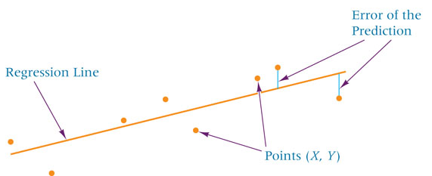
Least Squares Analysis
Least squares analysis is a process whereby a regression model is developed by producing the minimum sum of the squared error values
The vertical distance from each point to the line is the error of the prediction.
Notes:
Least Squares Fitting refers to the procedure for finding the best-fitting curve to a given set of points by minimizing the sum of the squares of the offsets ("the residuals") of the points from the curve. The sum of the squares of the offsets is used instead of the offset absolute values because this allows the residuals to be treated as a continuous differentiable quantity. However, because squares of the offsets are used, outlying points can have a disproportionate effect on the fit, a property which may or may not be desirable depending on the problem at hand.

Slide 7
Least Squares Analysis
Notes:
10
Here you can see the optimal values of b1 and b0 which results in minimizing the sum square of the residuals. For b1 we can see that the coefficient can be calculated as a ratio of the covariance of X and Y divided by the sum square of X. This can be expanded as the sum product of X and Y minus n times the product of the mean of X and Y divided by sum square of X minus n times the mean of X power 2. For the fixed intercept, b0, we can determine the value by calculate the difference between the mean of the Y and b1 multiplied by the mean of X.

Slide 8
Least Squares Analysis
Notes:
As you might have noticed, when calculating b1, the numerator of the fraction is equivalent to the sum square of X and Y and the denominator is the sum square of X.

Slide 9
Solving for b1 and b0 of the Regression Line: Airline Cost Example
Number of
Passengers
Cost ($1,000)
X
Y
X
2
XY
61
4.28 3,721 261.08
63
4.08 3,969 257.04
67
4.42
4,489
296.14
69
4.17
4,761
287.73
70
4.48
4,900
313.60
74
4.30
5,476
318.20
76
4.82
5,776
366.32
81
4.70
6,561
380.70
86
5.11
7,396
439.46
91
5.13
8,281
466.83
95
5.64
9,025
535.80
97
5.56
9,409
539.32
∑
X
= 930
∑
Y
= 56.69
∑
X
2
= 73,764
∑
XY
= 4,462.22
Notes:
12
Here is an illustrative example of how b₁ and b₀ can be calculated for a simple regression model. In this example we are trying to build a model to predict the cost of airlines in thousands of dollars based on the number of passengers. Subsequently the independent variable in this case is x, the number of passengers, and the dependent variable is cost represented by y. the data points are shown in the table below. You can see the cost of different number of passengers sorted from 61 to 97. Here we calculate the sum of x, the sum of y values, we can also calculate the sum of x², and also the sum of the products of x and y. for example, in this case, the sum of x values is 930, the sum of y values is 56.69, and the sum of the squares of x is 73,764, and the sum of the products of x and y is 4,462.22.

Slide 10
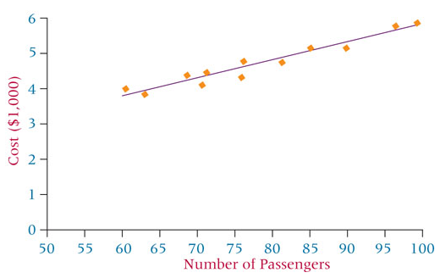
Solving for b1 and b0 of the Regression Line: Airline Cost Example
Notes:
13
Using the values calculated from the previous slide, we can show how we can calculate b1 and b0. So, to start let’s calculate the covariance of X and Y or the sum square of X and Y, which is equal to the sum of the products of X and Y minus the sum of X and sum of Y divided by the number of observations. So, the sum of the products of X and Y was 4,462.22 then we need to deduct the product of the sum of the X and the sum of the Y divided by the number of observations which was 12 in this case. So, the sum of X was 930, the sum of Y was 56.69 and we divide this by 12. The result would be 68.745. Now we need to calculate the sum of the square of X which would be equal to sum square of X minus the sum of the X values part two divided by n. Plugging the numbers, we will get this value as 1689. Beta is obviously the ratio of the SSxy and SSx and can be calculated as 0.0407. Now that we have b1, we can basically use the formula to calculate b0; b0 is the average of Y which is the sum of Y divided by n minus beta one average of X which is the sum of X divided by n. Plugging the numbers will give the value of b0 as 1.57. Now that we have b1 and b0, we can write the equation for Y, which in this case we have Y hat is equal to 1.57 plus 0.407 multiplied by X. So, we actually have our equation line calculated.

Slide 11
Hypothesis Tests for Model Coefficients
A hypothesis test can be conducted on the sample slope of the regression model to determine whether the population slope is significantly different from zero.
Testing the slope of the regression line to determine whether the slope is different from zero is important.
If the slope is not different from zero, the regression line is doing nothing more than the average line of y predicting y.
Notes:
The t-tests or z-tests are used to conduct hypothesis tests on the regression coefficients obtained in simple linear regression. A statistic based on the t or z distribution is used to test the two-sided hypothesis that the true slope, beta1, equals zero. If the slope is not different from zero, the regression line is doing nothing more than the average line of y predicting y. As a results, a business analyst who is working on a project may hope that this hypothesis can be rejected to illustrate that there is a statistically significant relationship between the dependent and independent variables. We will discuss hypothesis test of the coefficients in more details in the next presentation.

